Slide 1



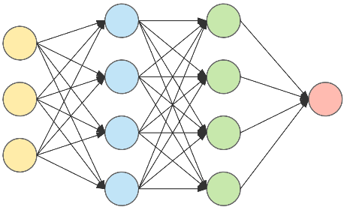




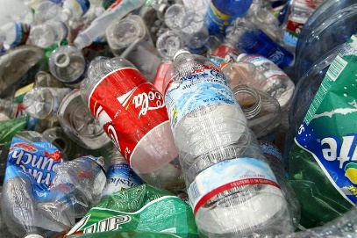


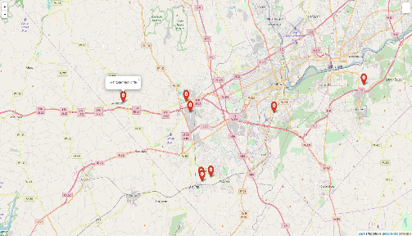
Upload to database
with location
Neural Network
output the label
P
Plastic
W
P
Waste
Take Plastfies
2
1
3
4
Profiling
REDUNDANCY
REMOVAL
MULTIPLE
OBJECT
DETECTION
SCHEDULER
MAP
&
STATISTICS
Store Label in CSV file
and
analyze it
Plot statistics on map
Creation of statistical Diagram

